Slide 1
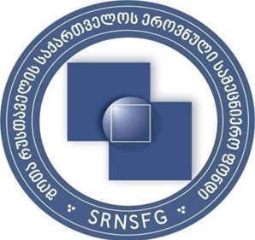

Truso,
In Waiting for Happy People

Slide 2
This study has been accomplished with the financial assistanceof the Shota Rustaveli National Science Foundation of Georgia, within the framework of the project Demography and Cultural Identity of the Truso Gorge Population
Lia Akhaladze,Doctor of Historical Sciences
Nino Shiolashvili, Doctor of Historical Sciences
Tamar Pkhaladze, Doctor of Historical Sciences
GvantsaBurduli, Doctor of Historical Sciences
Gela Kistauri, Doctor of Historical Sciences

Slide 3
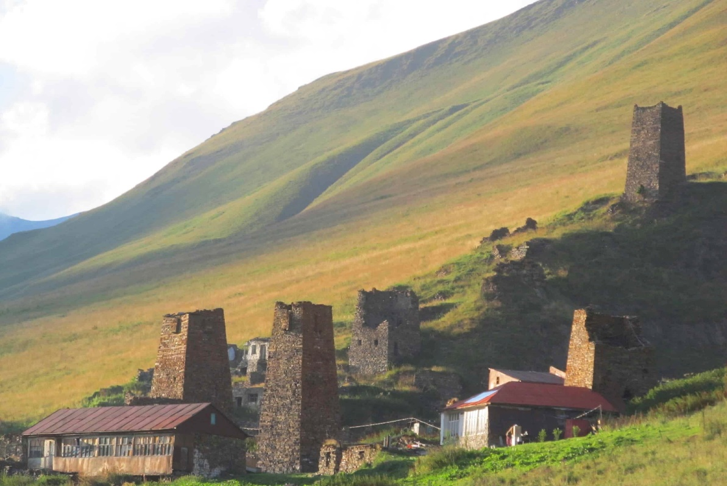
Truso

Slide 4
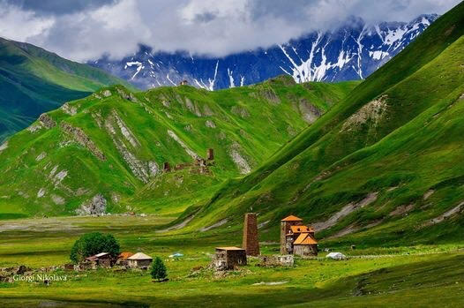
Truso

Slide 5
Truso,
In Waiting for Happy People
The aim of theseworksis to observe the history of the Truso Gorge in the realm of the developments that took place there, starting from the 18th century;viewing it as the arena of mutual settlement of Georgians and Ossetians, traditional cohabitation, and the areal of certain cultural diffusion.
The methodological study is based on the method of Contrastive analysis of historical sources, fact-finding, and content analysis.

Slide 6
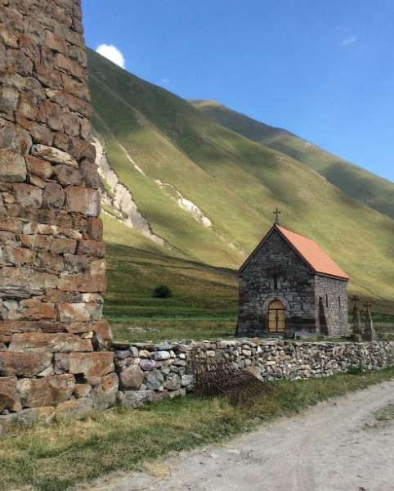
For centuries, Georgia, due to its geopolitical, economic, and social factors has been the migration arena for different ethnic groups and peoples. Over time, some groups of migrants blendedwith thelocal population or with other ethnic entities, while the rest, managed to preserve their national specifics till the end. This process was particularly evident in the borderline regions of Georgia, among them, in Truso, one of the most ancient parts of Georgia. Truso is a rather rich and interesting gorgeowing to its historical past, socio-economic and political importance, mode of life of its population,and the development of itsmaterial and spiritual culture

Slide 7
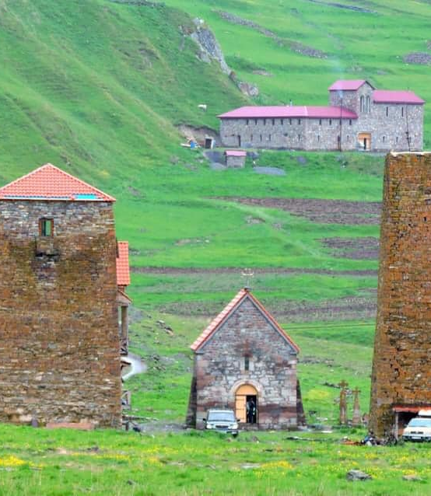
From ancient times, Truso was inhabited by the Dvals, one of the Georgian ethnic groups, but in the first quarter of the 18th century, a new ethnic element, namely Ossetians emerged there, who introduced specific elements of life and traditions in the region and factually correlated the existing indigenous culture; though Truso as the region of the oldGeorgian settlementpreserved the basic elements of national culture, namely: Georgian writing culture and Georgian writingsystem in the form of epigraphic monuments, tower houses, characteristic for the mountainous regions of Georgia (Svaneti, Khevsureti, Mtiuleti, Tusheti), backed towers (towers with one the rounded side)designed for the fortification means, and many other artifacts that at one glance seem remote and hard to reach, in reality, is very near and their historical chronometry is imprinted on the sites of 17 deserted villages of the Truso gorge. as if the time has stopped in Truso where neither Georgian highlanders, Dvals, nor Ossetians live there today. One part of Ossetians returned to their historical homeland,the second part would live in different parts of Georgia. As for the Dvals, this ethnographic group does not exist today anymore

Slide 8
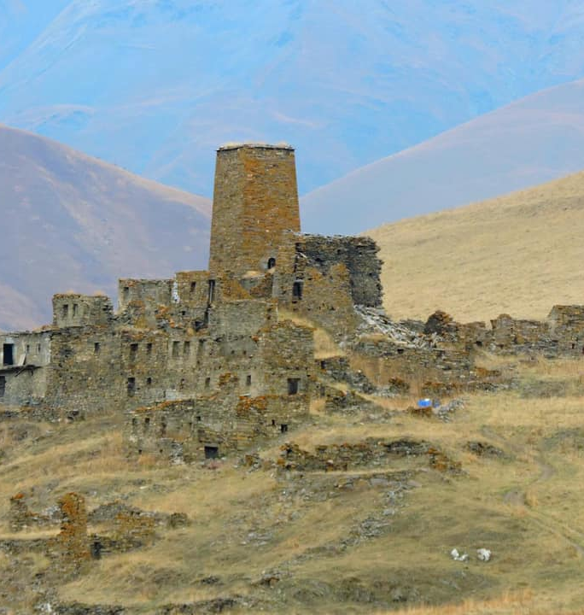
The Truso Gorge is empty of the population (there are about 17 deserted villages there). The first massive migration of Ossetians from the gorge started at the end of the 19th century that is registered by the Russian census. (e.g. see 1873 census (CHAG, fund: 254) on the territory of Georgia remained, though moved towards south to the lowlands; part of them returned to their historic motherland, to Ossetia (Present North Ossetia, Russian Federation). Leaving the Gorge by the population was conditioned by a number of processes: severe climate, the nonexistence of the possibility of employment and education, low level of economic and social development of the region, and subsistence production that finally made the people leave the gorge.

Slide 9

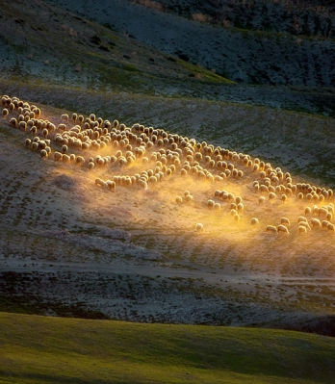
In the second part of the last century, Ossetians who migrated to North Caucasia and would visit the Truso Gorge, the place of their former habitat only during a certain season, namely, from spring to autumn when bringing the cattle for spending summer on postures there. Though, later, the lack of prospects in the development of sheep breeding resulted in the malfunctioning of this branch of occupation too.

Slide 10
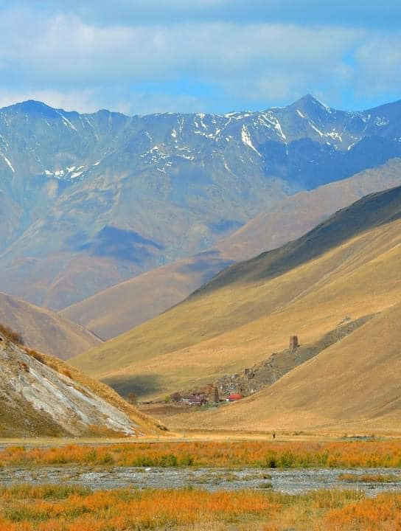
In the second half of the 80th of the 20th century, the movement for national independence that started in Georgia and in some republics of the Soviet Union would cause the enhancement of the soviet propaganda machine in borderline regions of Georgia (Abkhazia, so-called South Ossetia, Truso) where lived the mixed ethnic population. It was coupled with the severe economic crises of 1990th and the failure of the infrastructure that lead to the isolation of the Gorge from the central inhabited areas and finally resulted in the migration of the population from there.
The situation even more deteriorated with the 2008 Russian - Georgian war, which was followed by the closure of the Russian-Georgian border (Larsi check-point) and the breaking of diplomatic relations between the states.

Slide 11
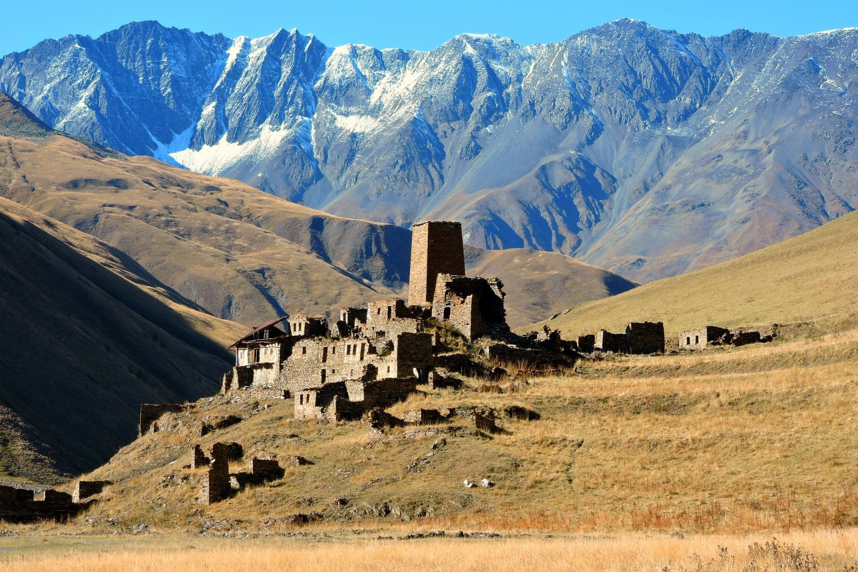
You may know that the claims, on the Georgian territories after the Russian aggression of August, 2008, and the occupation of Akhalgori, have increased even more. Russian and Ossetian scientists and the press would launch and disseminate the false propaganda and information on this part of Georgia, presenting the Truso Gorge as “ancient Ossetian territory”. From time to time, in the Russian language newspapers, we encounter the letters (that are encouraged and supported by the Russians) forged by the Ossetian authors and Ossetian civil organizations (e.g. “Dariali”) where they claim that the Truso and Dariali Gorges situated in Kazbegi municipality, as well as the territory of the villages in the Kobi basin, belong to Ossetia and thus should be included in the composition of South Ossetia. Even more, the map published on the website of “Dariali” shows that Gori, Mtskheta, and the Military Road of Georgia are within the borders of South Ossetia. These people completely ignore the interests of the local Georgian population, historical written documents, even the census and documents compiled by Russia, or the legacy of the Georgian population, the epigraphic monuments written in stone that are the collective historic memory and the true evidence of their cultural identity

Slide 12
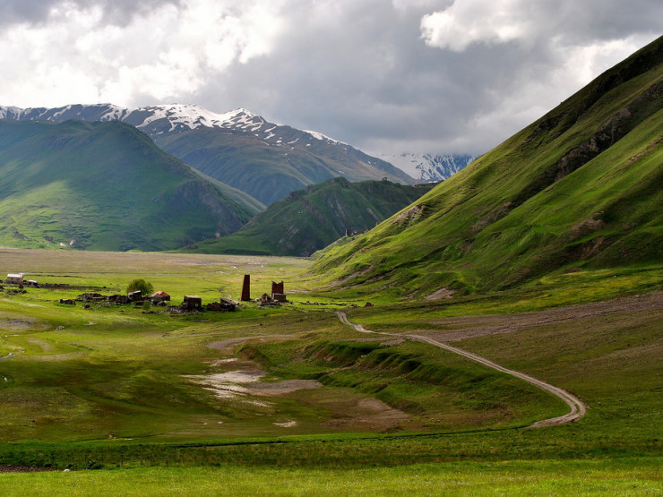
Ossetians that stayed in Georgia, live in different historical regions of the country and are actively involved in its political, economic, and cultural life. They are represented in the state management system, in scientific circles, in sports, business, and other spheres. They participate in the country’s defense, represent Georgia at various international meetings and talks, scientific forums, and sporting events and their majority consider Georgia to be their homeland. Frankly speaking, it is rather awkward for Georgians and Ossetians, the descendants of King Tamar and Davit Soslani, Quins of Borena and Bordokhan, the ones who have been tied with the oath of loyalty throughout the centuries and managed to preserve our country overcoming the historical calamities, when today, the third-party lectures us about the necessity of peace.
While Truso, as the strategic region of Georgia and the area of Georgian-Ossetian cultural diffusion still waits for the people who would care for the past and ensure the happy, successful future of the gorge.

Slide 13
